Slide 1
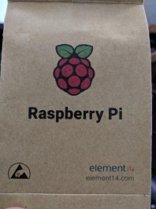

Tesseract
NON-Standard Linux OCR Library
Has everything needed to extract text from an image file (PNG, JPG, ETC)
Easy to implement once recognizing the difficulties
Font selection is very important
Distance from camera and font size also very important

Slide 2
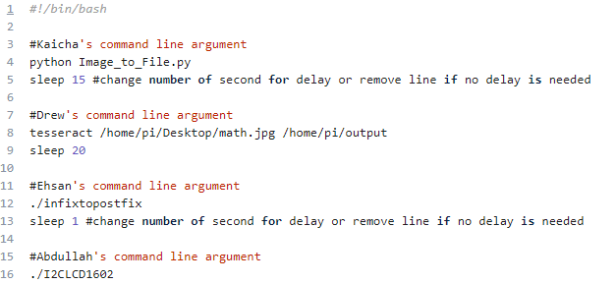
BASH
Command line automation
Can implement logic statements
A single type of shell among many

